Slide 1

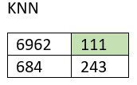
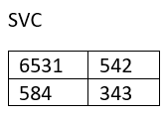
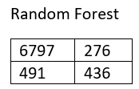
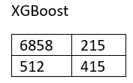
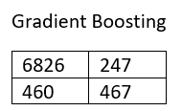
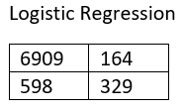
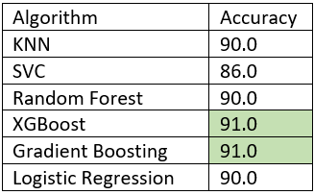
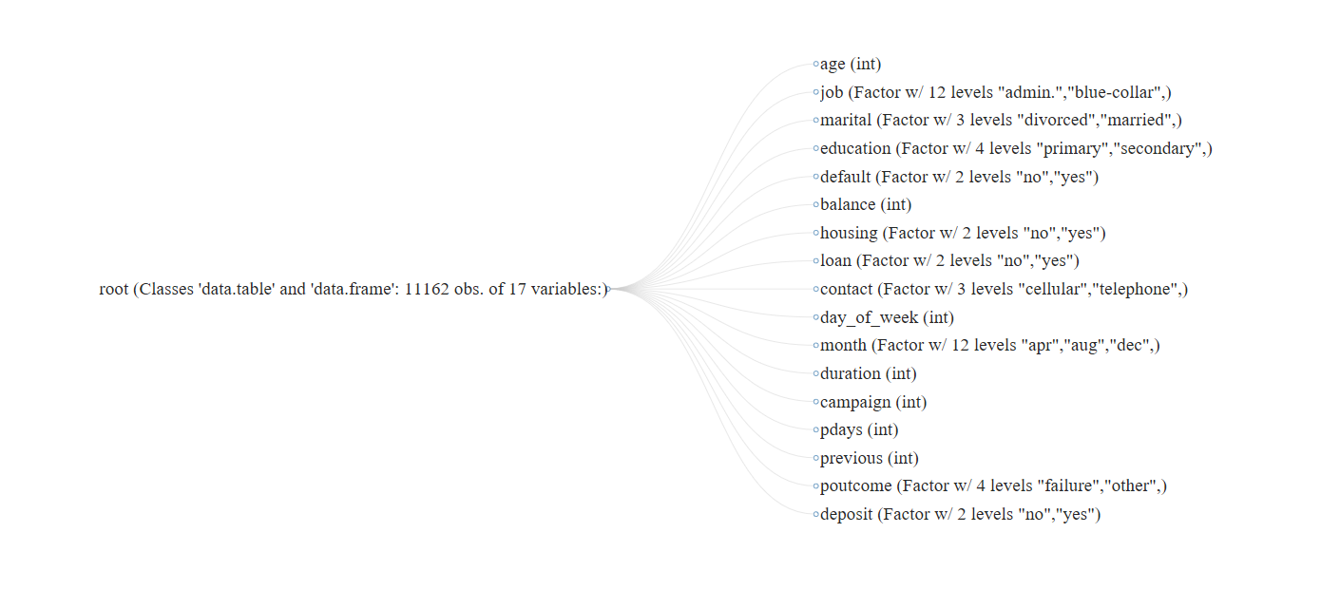
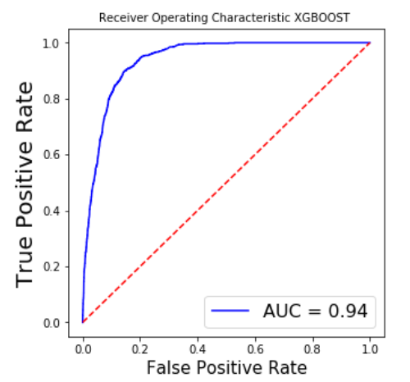
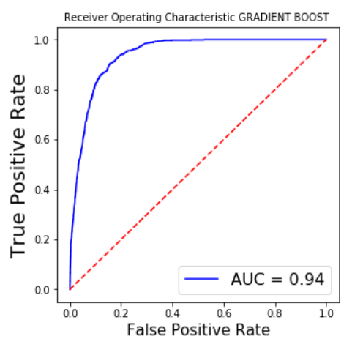
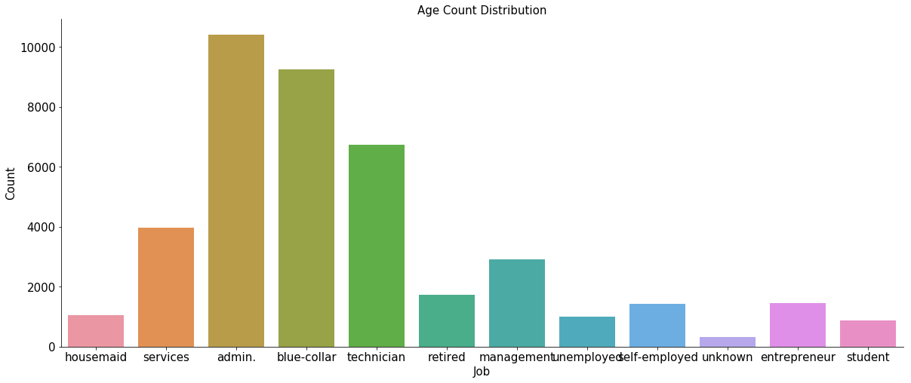
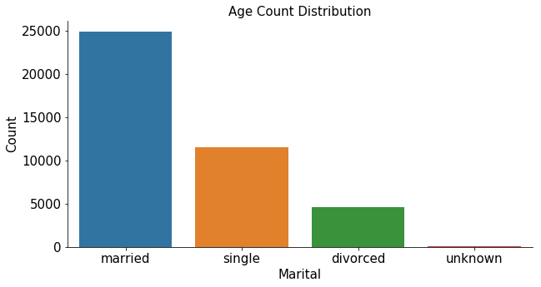
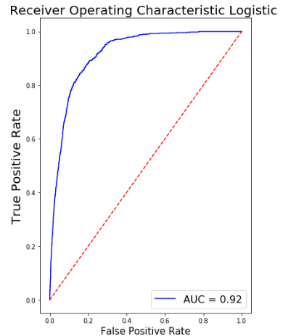
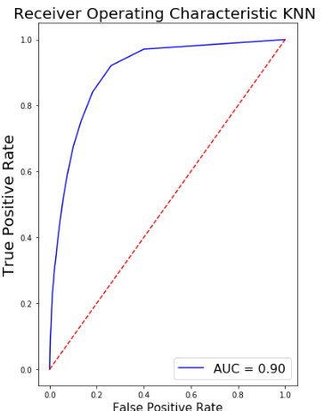
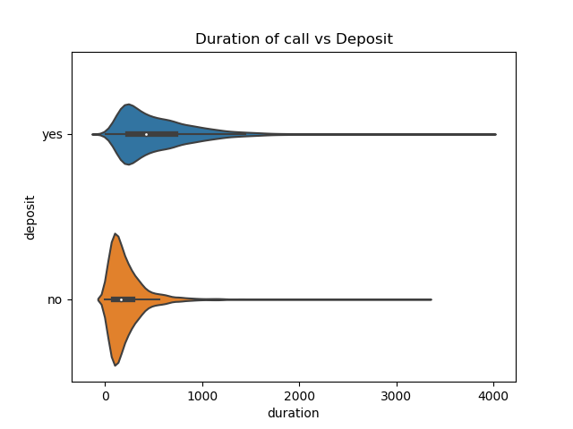
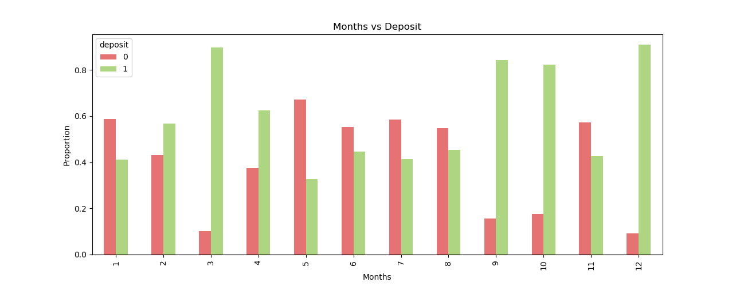
INTELLIGENT TARGETING- BANK MARKETING DATA
Authors: Suprajah Suresh, Sucharitha Batchu, Aneesh Shinde
Instructor: Prof. Amir H. Gandomi
Business Intelligence & Analytics
INTRODUCTION
Data is related with direct marketing campaigns (phone calls) of a Portuguese banking institution.
Marketing campaigns were based on phone calls.
OBJECTIVE
The classification goal is to predict if the client will subscribe a term deposit.
To perform exploratory data analysis and find the best machine learning classification algorithm to better fit the data.
RESULTS
Algorithm is picked using cross validation results, least False Positive rates and high precision on negative predictions.
Area under curve (AUC) metric is used to measure accuracy.
DATA ANALYSIS
The data has 6 continuous and 11 categorical variables.
Data is left skewed and therefore creating imbalanced dataset.
Imbalanced dataset is treated with random under and over sampling techniques .
The ages factor has a medium dispersion and do not seem to relate with other variables
Jobs, Marital status and Education are the best factors to analyze if a customer will subscribe.
CONCLUSION
Focus should be on reducing the false positive rate rather than accuracy to advertise to all prospective customers.
K nearest neighbors (KNN) has the least false positive number of just 111 customers.
The months of March and December have the highest probability of getting customers to enroll.
Duration of the call plays an important factor. Generally, calls more than a minute can convince people to subscribe to a term deposit.
http://www.stevens.edu/bia

